Slide 1


P3 HEURISTIC EVALUATION:
UX CHECKS ON GALLERY EXPLORER APP
By: K2Z Studio
Kriti, Kally Chua, Zhiqing Zhao

Slide 2
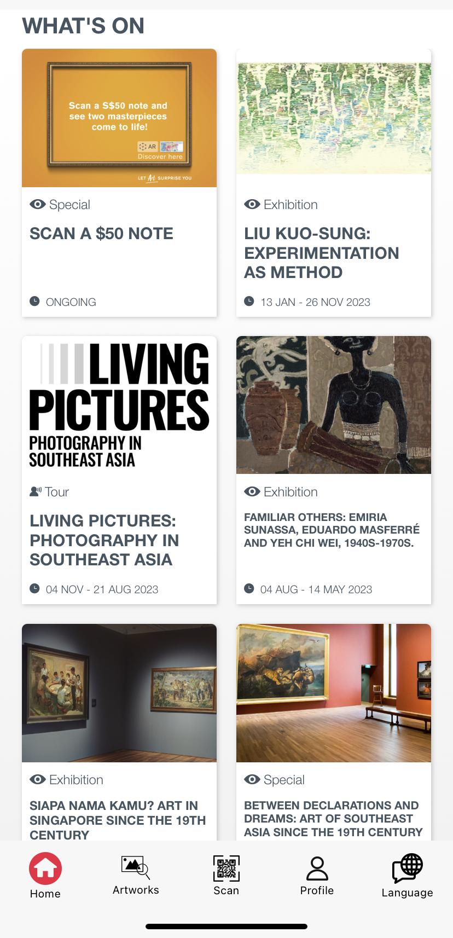
Consistency & Standards:
Fonts on 'What's On' cards differ
User control & Freedom:
Lack of ticketing information on ‘What’s On’ cards i.e., free or if requires ticket fees

Slide 3
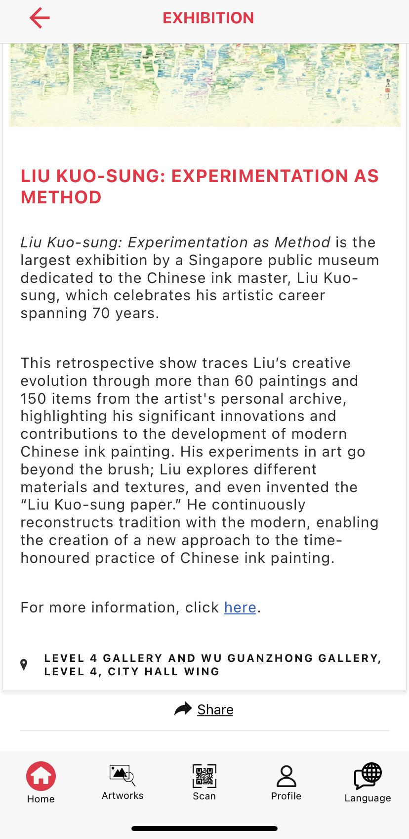
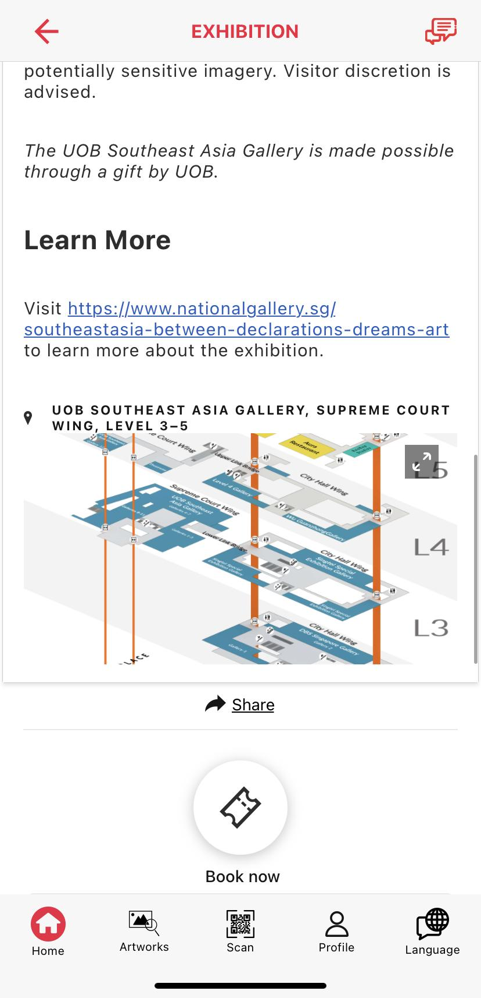
Consistency & Standards:
Map' and 'Book Now' doesn't appear on all pages

Slide 4
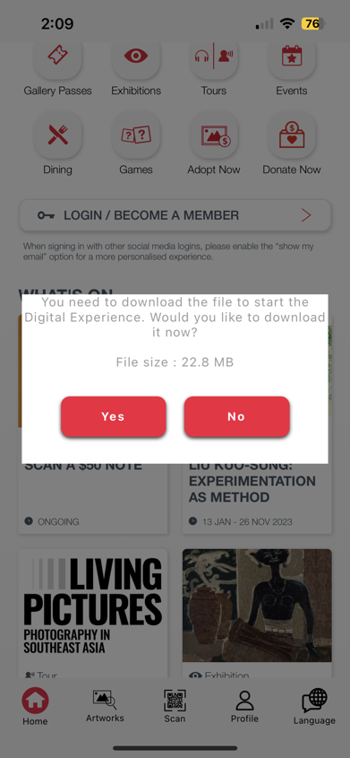
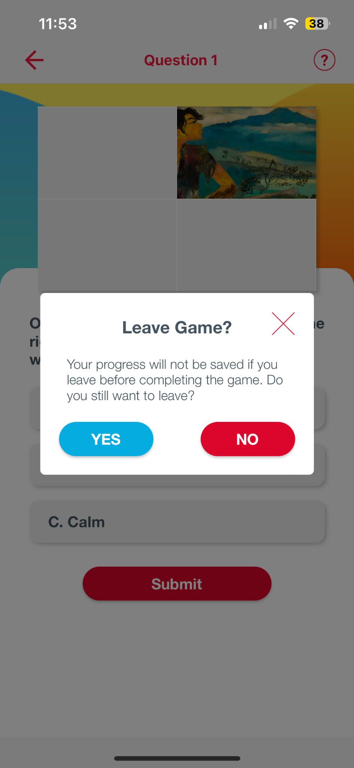
Consistency & Standards:
The pop-up does not match the pop-ups at other places, text and font color is different.
Visibility of System Status:
Users are unsure what file this is, no description provided, users clicked on scan a note and expect a scanner to open instead of the pop-up.

Slide 5
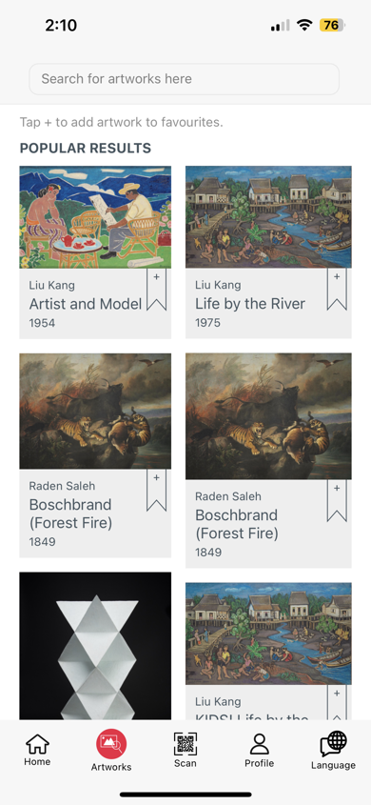
Recognition rather than recall:
Filters are missing. If a user wants to explore other exhibitions than the ones mentioned here, there is no other way to do that than rely on your own knowledge.

Slide 6
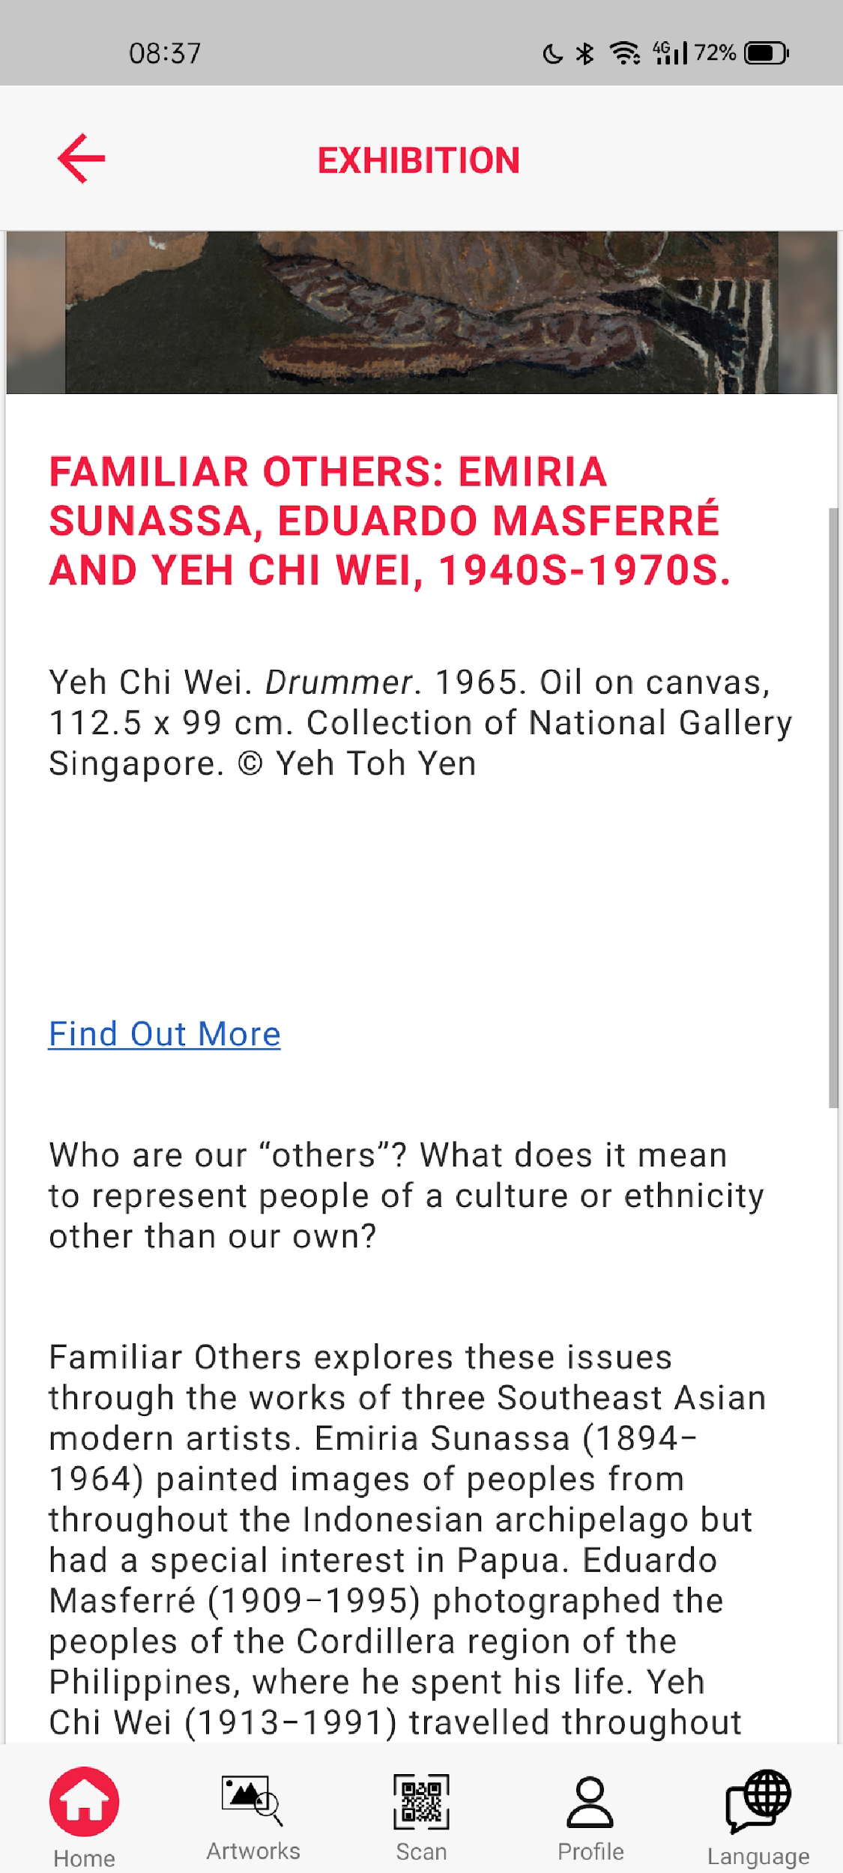
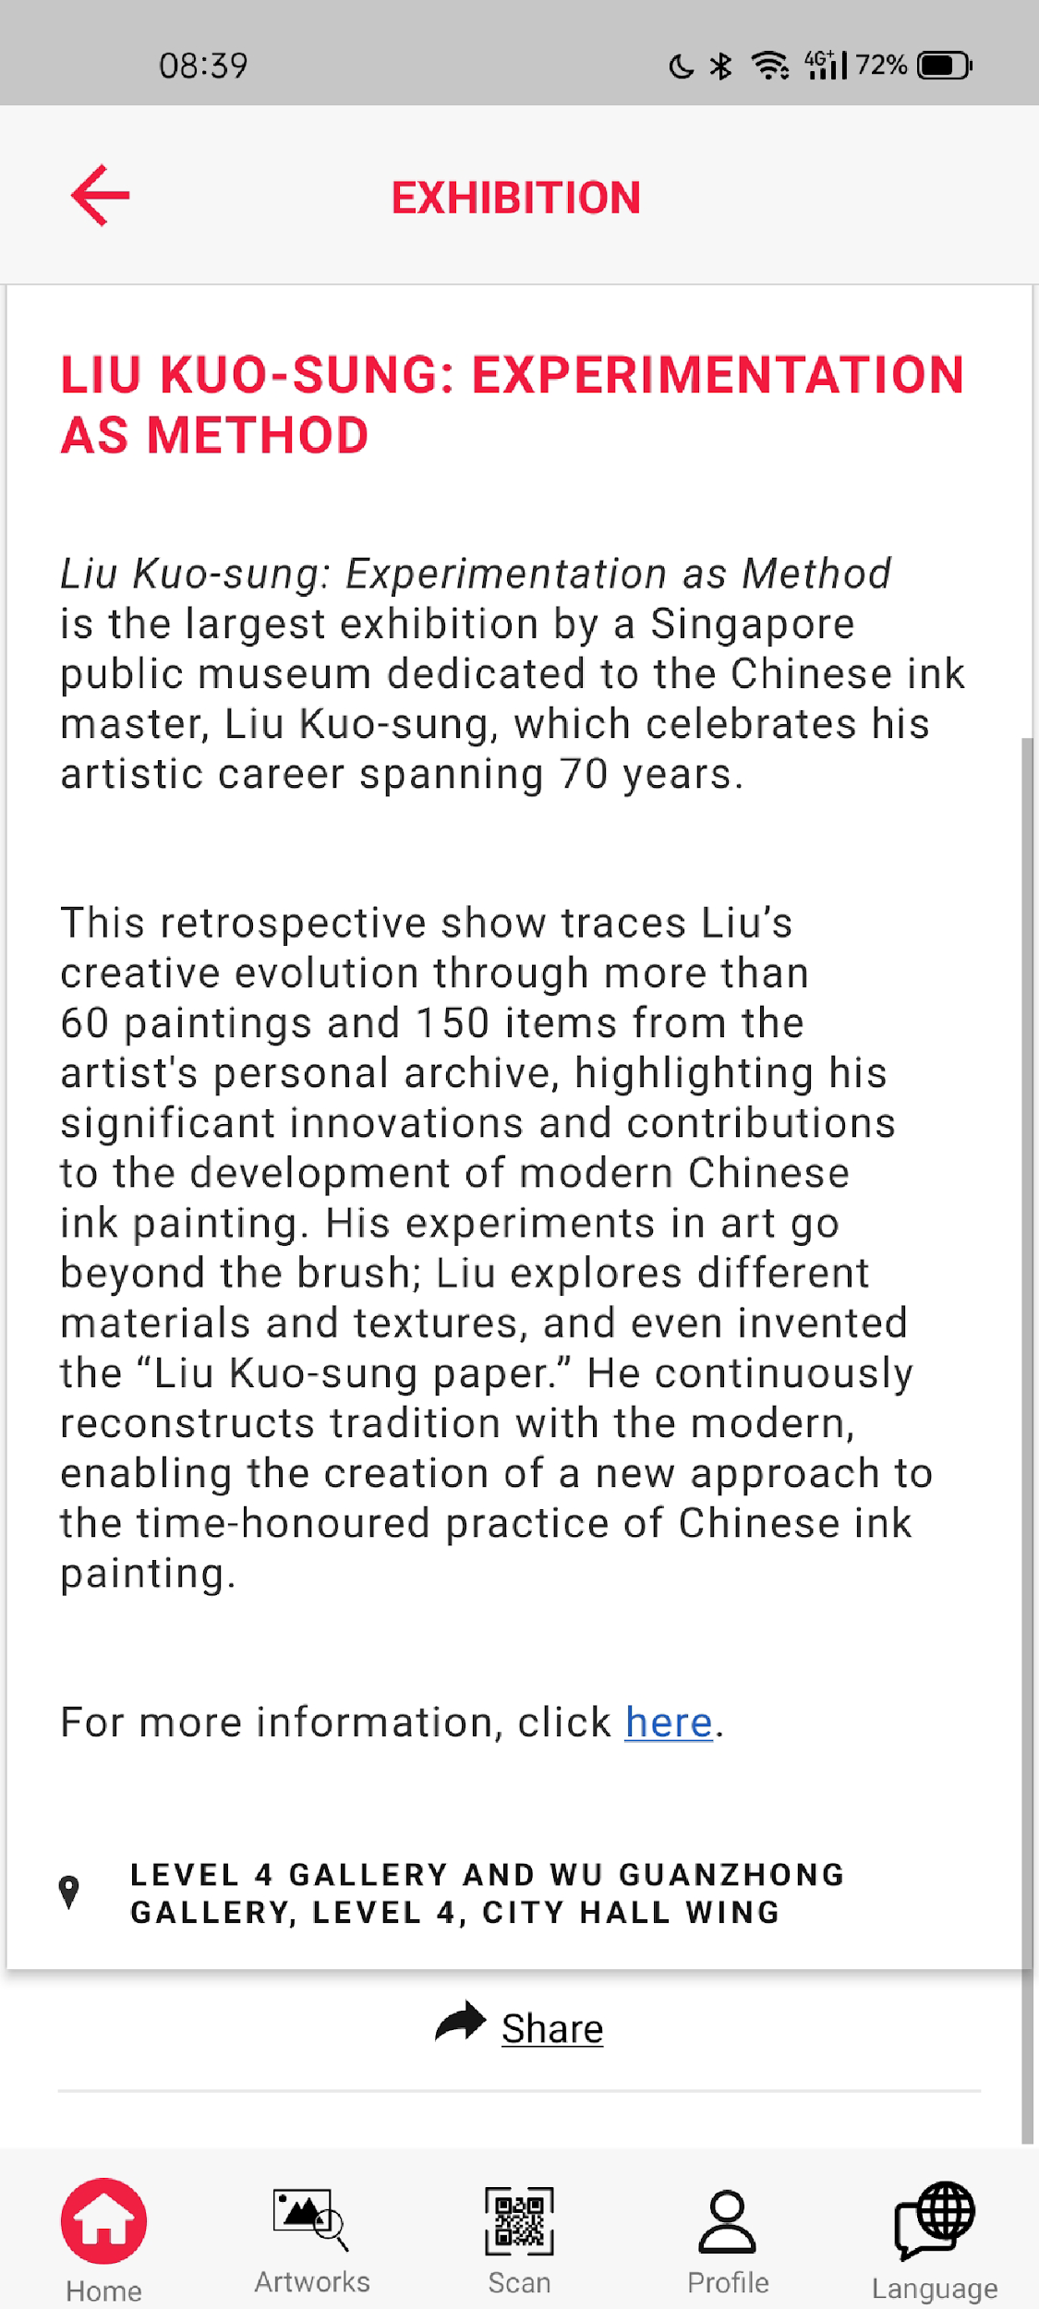
Consistency & Standards:
Exhibition details are different: Click ‘here’ vs. ‘Find out more’.

Slide 7
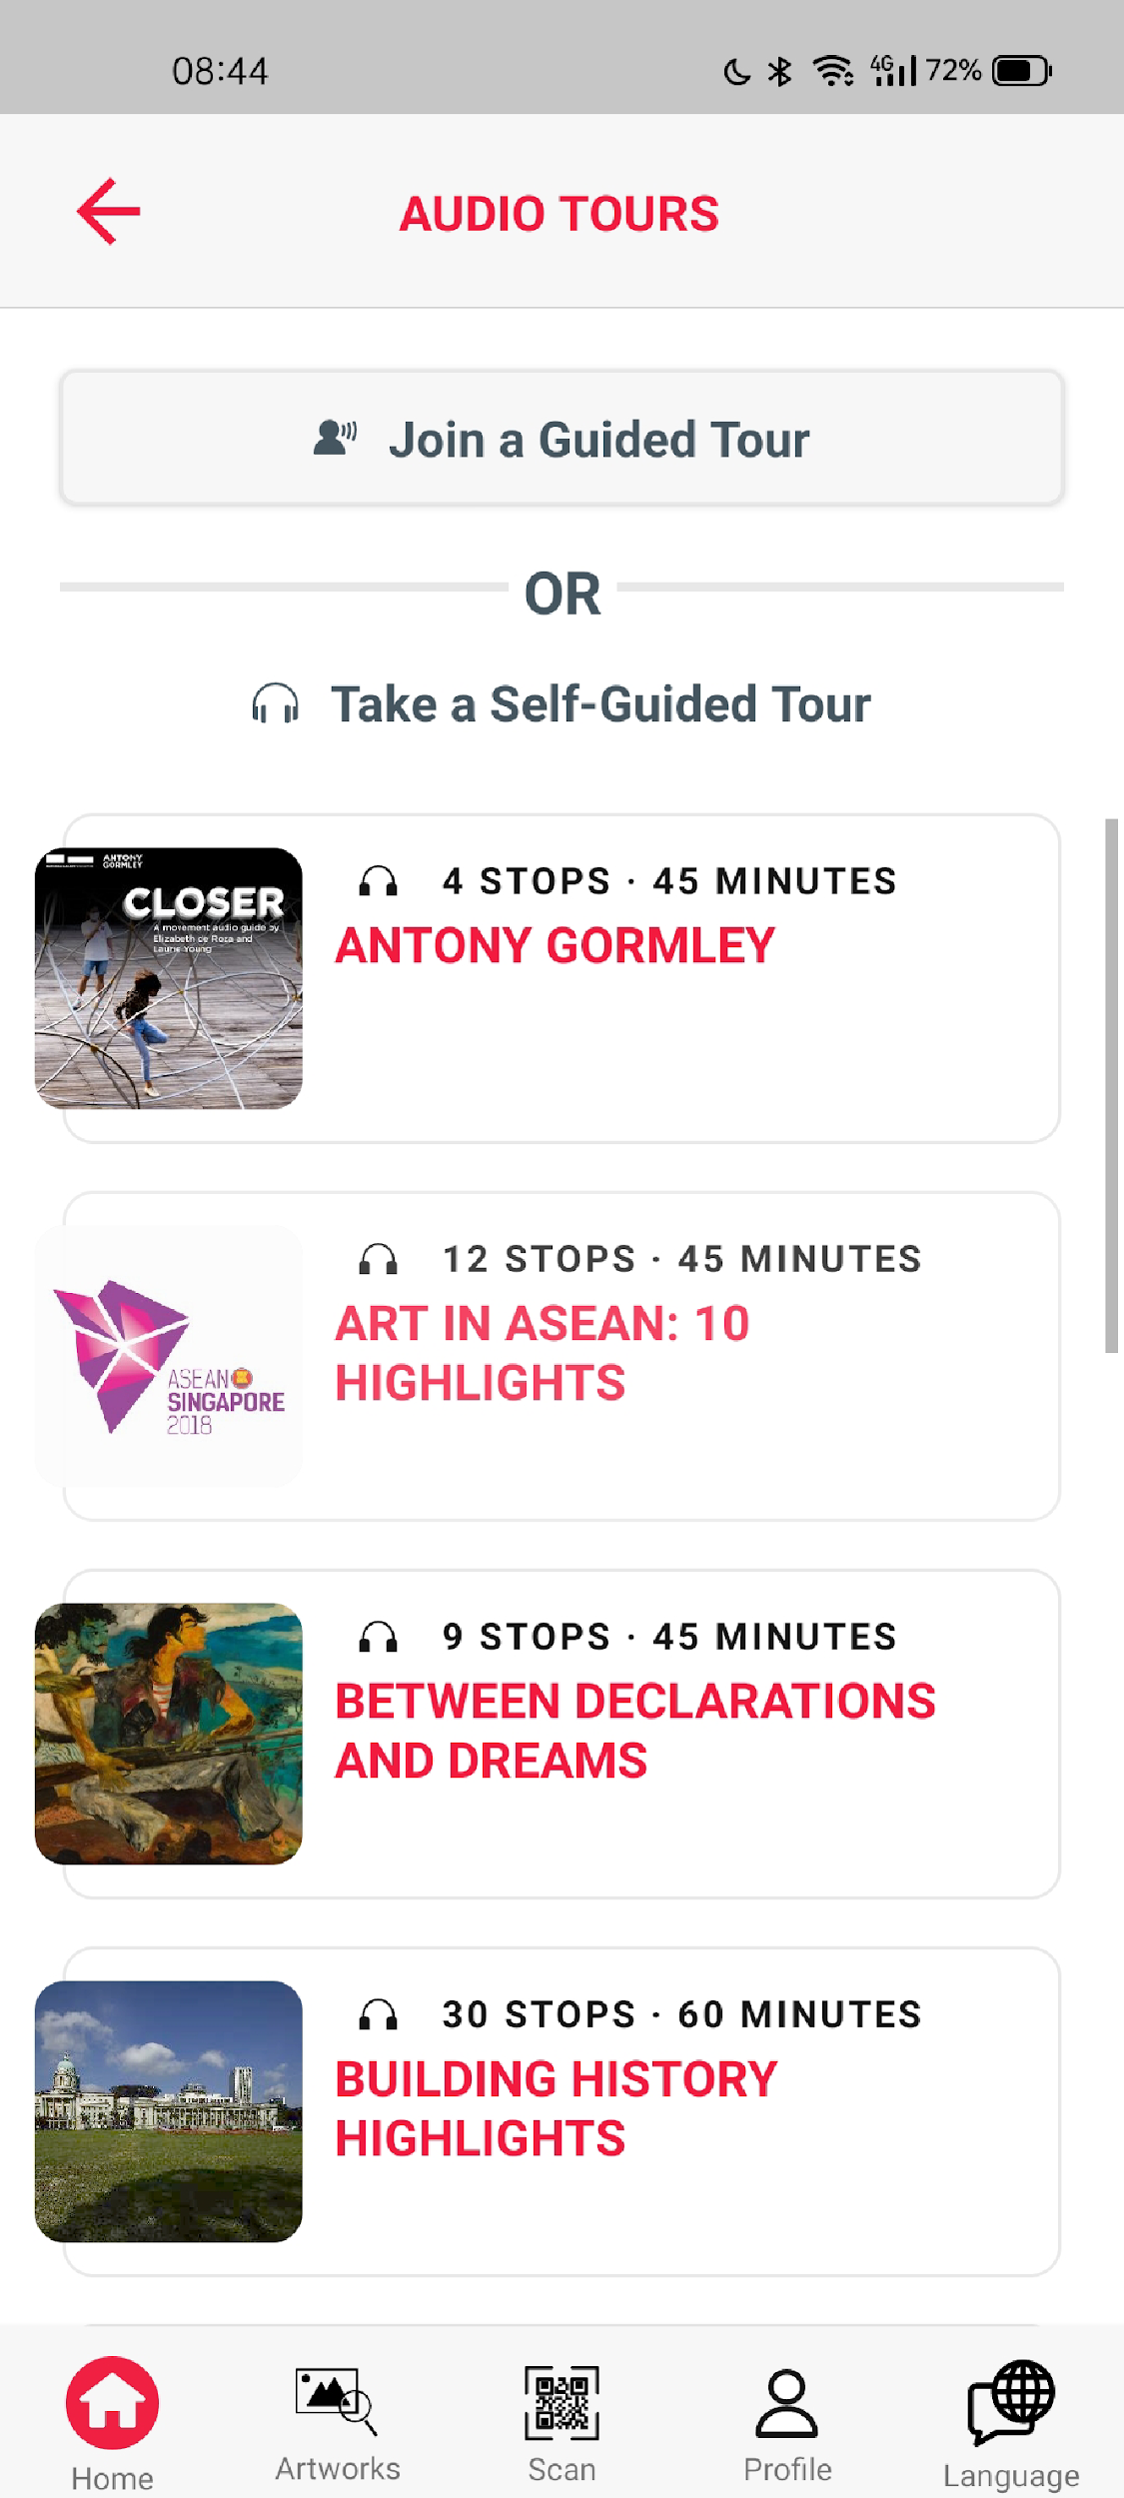
Consistency & Standards:
Tours->page title is AUDIO TOURS where this page included guided tours button & self-guided tours

Slide 8
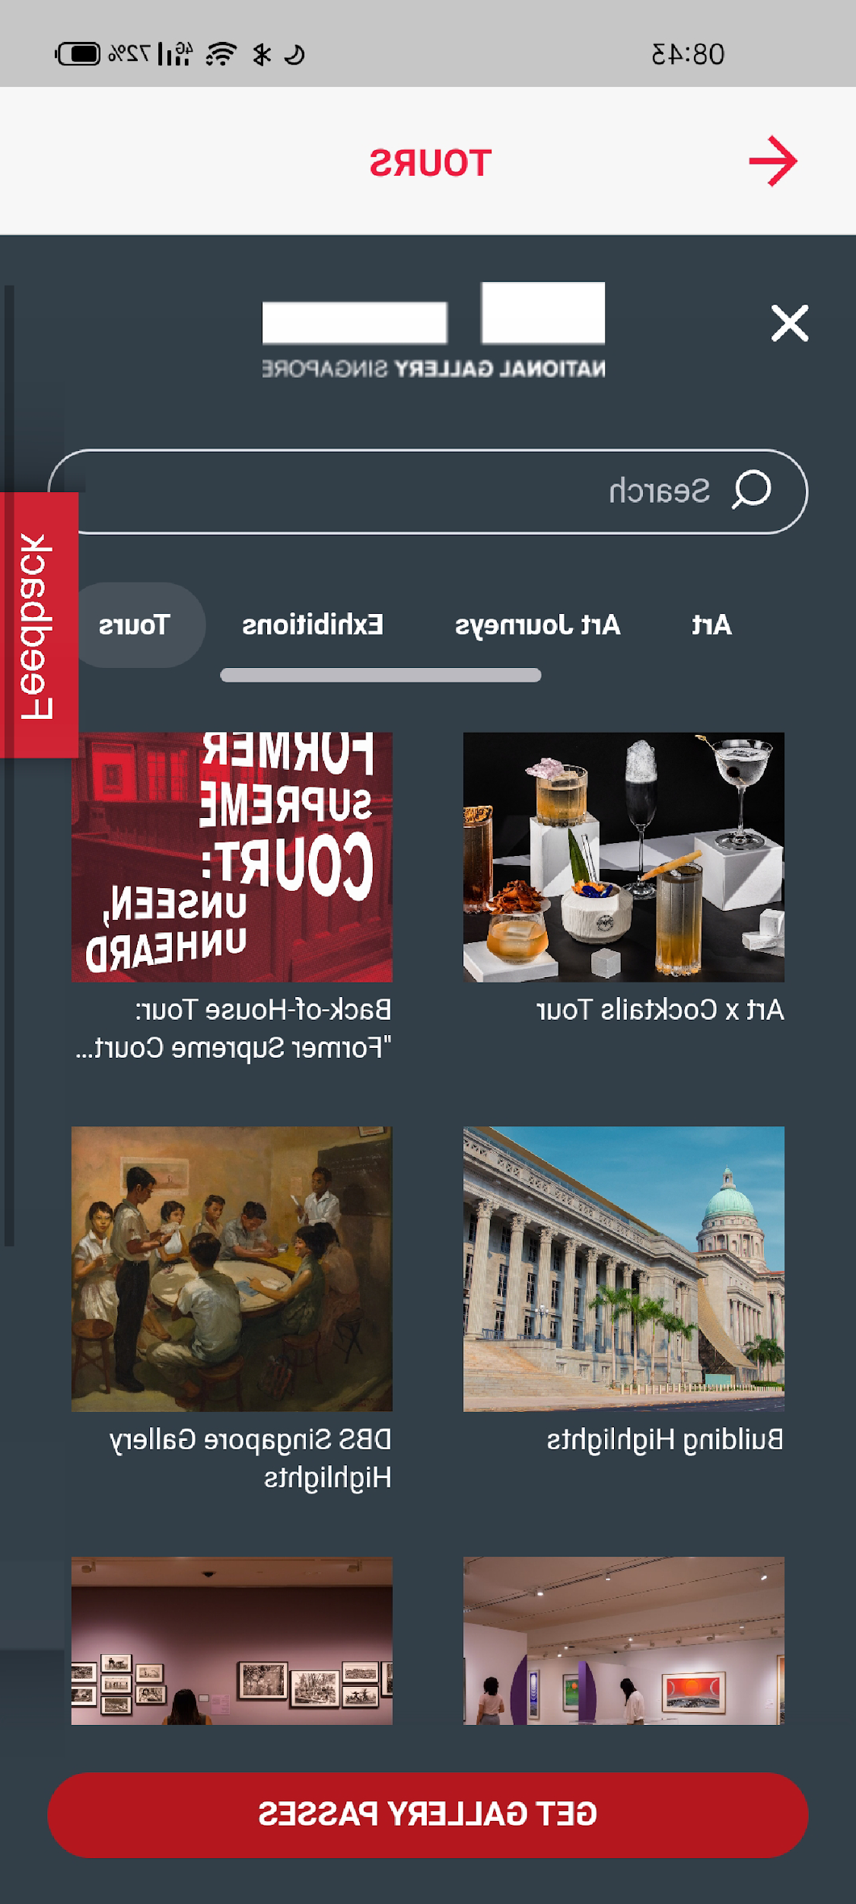
Match between system and the real world:
Cross works as back button whereas users expect to use this to close this section instead of going back

Slide 9
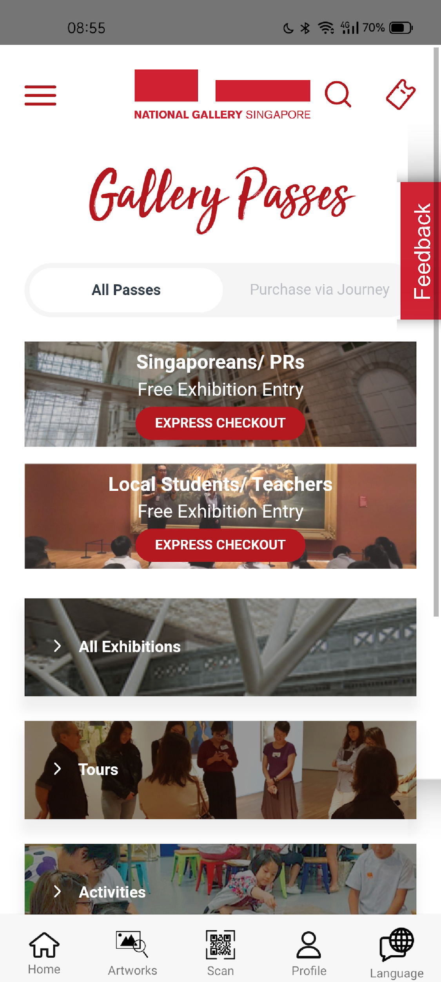
Visibility of System Status:
Art Journey tab is not visible.

